Slide 1
Lecture 2: ML Basics + Spam Filtering
Siddharth Garg
sg175@nyu.edu

Slide 2


Classification
Task (T):
Emails $x∈all possible emails$and y$∈{\{spam,non_spam\}}^{}$ find
$$f:x→y$$
Experience (E):
A ”training dataset” a emails marked as “spam” or “non_spam”
Performance (P):
SPAM
Spam detection accuracy
“Supervised Learning (Classification)”

Slide 3
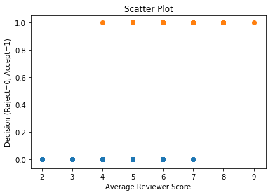
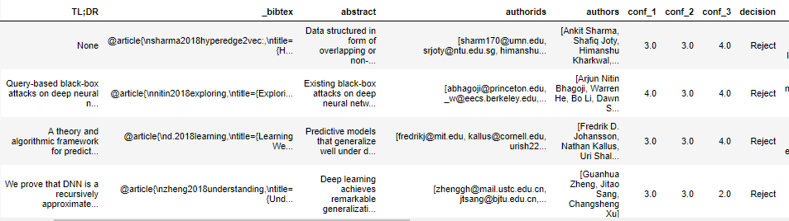
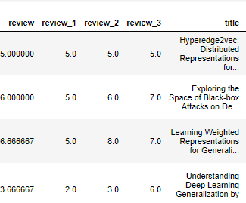
Binary Classification
“Categorical
variable”
Can you fit a linear model to this data?
Binary Classification Task (T):
v
Simplest example where and
Dataset of ICLR’18 review scores vs. accept/reject decisions
v

Slide 4
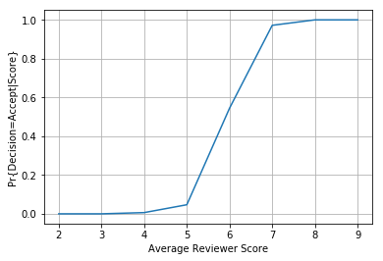
Logistic Regression
Pr{Decision=Accept|Score}
Binary Classification Task (T):
v
Instead, let’s compute and plot
Idea: Linear regression to fit p as a function of x
Is this a good idea?
Probability p is always bounded between [0,1]
p
x

Slide 5
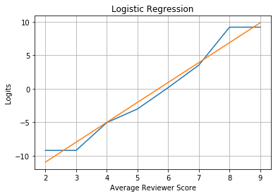
Logistic Regression
“Logits” Function
Binary Classification Task (T):
v
Consider the following function:
Ground-truth
What is the range of g?
Logistic Regression: fit logits function using a linear model!
Linear fit*
g
x
Note: the linear fit is illustrative only. How to determine the best linear fit will be discussed next!

Slide 6
Logistic Regression
Pr{Decision=Accept|Score}
What is Pr{Decision=Reject|Score}
How do we find the model parameters β₁ and β₀?

Slide 7
Model Estimation
We will use an approach referred to as Maximum Likelihood Estimation (MLE)
Let’s assume that the model(i.e., β₁ and β₀) is magically known. Consider the training dataset below. What is the likelihood that the dataset came from our model?
# | X | Y
1
2
..
..
N

Slide 8
Model Estimation
We will use an approach referred to as Maximum Likelihood Estimation (MLE)
Let’s assume that the model(i.e., β₁ and β₀) is magically known. Consider the training dataset below. What is the likelihood that the dataset came from our model?
# | X | Y
1
2
..
..
N

Slide 9
Model Estimation
We will use an approach referred to as Maximum Likelihood Estimation (MLE)
Let’s assume that the model(i.e., β₁ and β₀) is magically known. Consider the training dataset below. What is the likelihood that the dataset came from our model?
v
# | X | Y
1
2
..
..
N
Function of model parameters only
Find β₁ and β₀ that maximize g
(or minimize the “loss” –g)

Slide 10
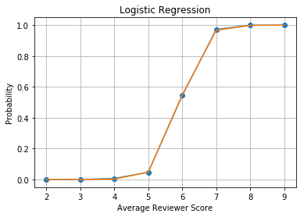
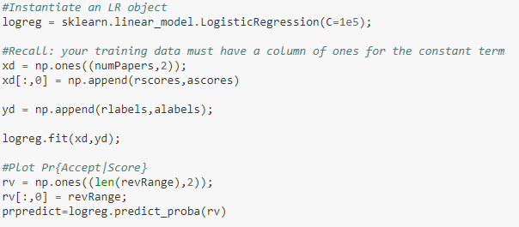
We Won’t Worry About How
Ground-truth
LR
From regression to classification: if probability of Accept > 0.5, then output Accept.

Slide 11
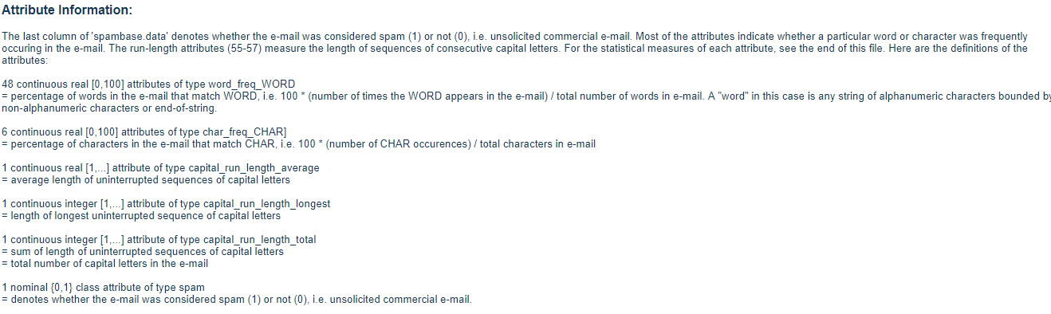
Logistic Regression: Multi-Variate Case
UCI Spam Dataset:
https://archive.ics.uci.edu/ml/datasets/Spambase
57 Real or integer valued features
Binary output class

Slide 12
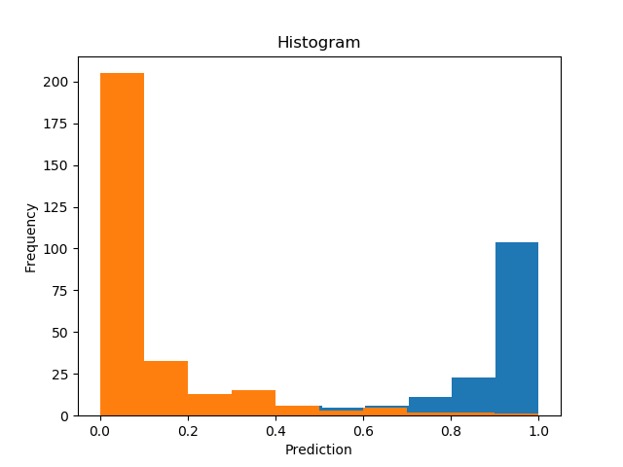
LR on Spam Database: Results
90% of samples used for training, remaining 10% used for test
Prediction probabilities for all “SPAM” emails in the test set
Prediction probabilities for all “SPAM” emails in the test set
Which emails are mis-predicted?
Accuracy on test set: ~92%

Slide 13
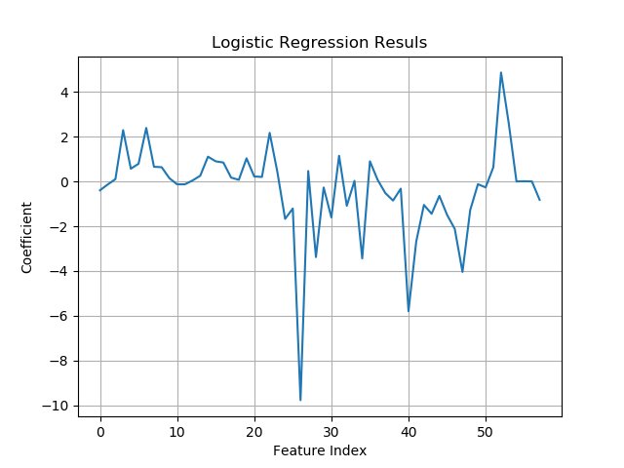
Which Features Matter?
Our Model:
What does β_{i}=0 imply about feature i?
char_freq_$:
Reasonable hypothesis: features with larger absolute values of β matter more.
“cs”
“George”

Slide 14
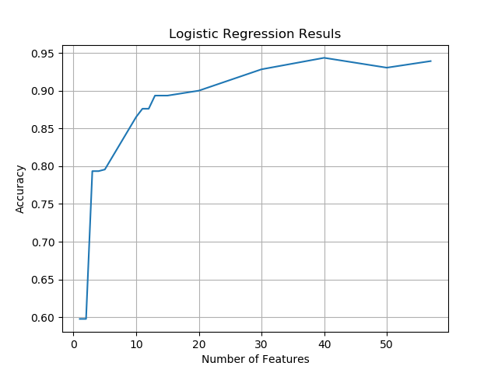
Feature Selection
Retrain and predict using only the top-k features
Can we explicitly train the parameters so as to prioritize a “sparser” model?
Why?
Low model complexity prevents overfitting!
80% accuracy using only3 features
Recall that during training we were seeking to minimize:
How should this objective function change?

Slide 15
Regularization
L_{p} Norm of a vector x
p | L_{p} Norm | Interpretation
0 |  | Number of Non-zero Entries
1 |  | Sum of absolute values
2 |  | Root mean square
 |  | Max. value
c controls the relative importance of the regularization penalty
“Regularized” loss

Slide 16
Regularization In Practice
Hard “combinatorial” optimization problem!
L0 Regularization
Instead, the following regularization functions are commonly used:
L1 Regularization
(LASSO)
We are penalizing “large” coefficients.
But why?
L2 Regularization
(Ridge)

Slide 17
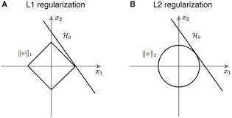
LASSO and Ridge Regularization
Contour of loss function
Contour of LASSO function
LASSO prefers sparse solutions!

Slide 18
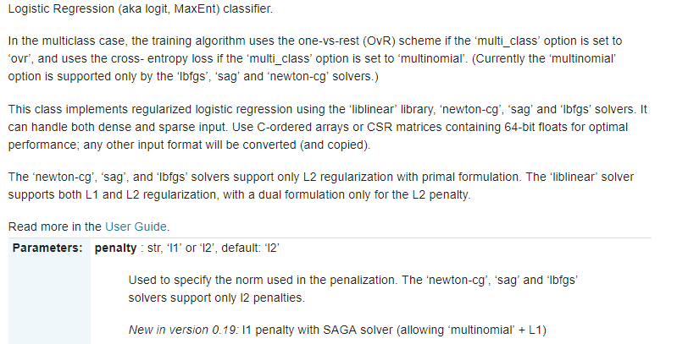
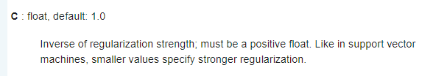
Regularization for Spam Classification
Which regularization function to use?
How should we select c?

Slide 19
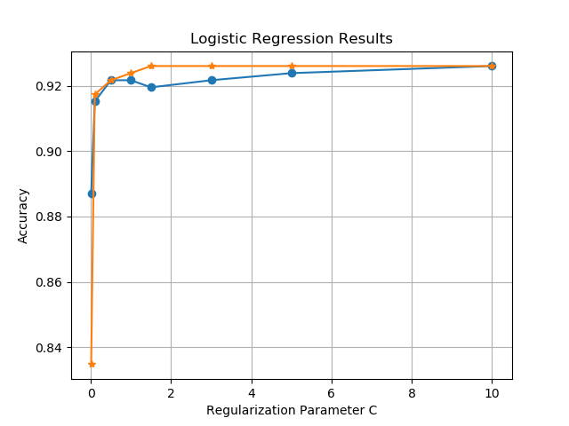
Impact of C
Best result
Ridge (L2)
Lasso (L1)
Increasing model complexity

Slide 20
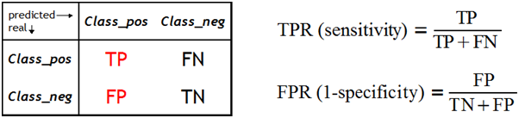
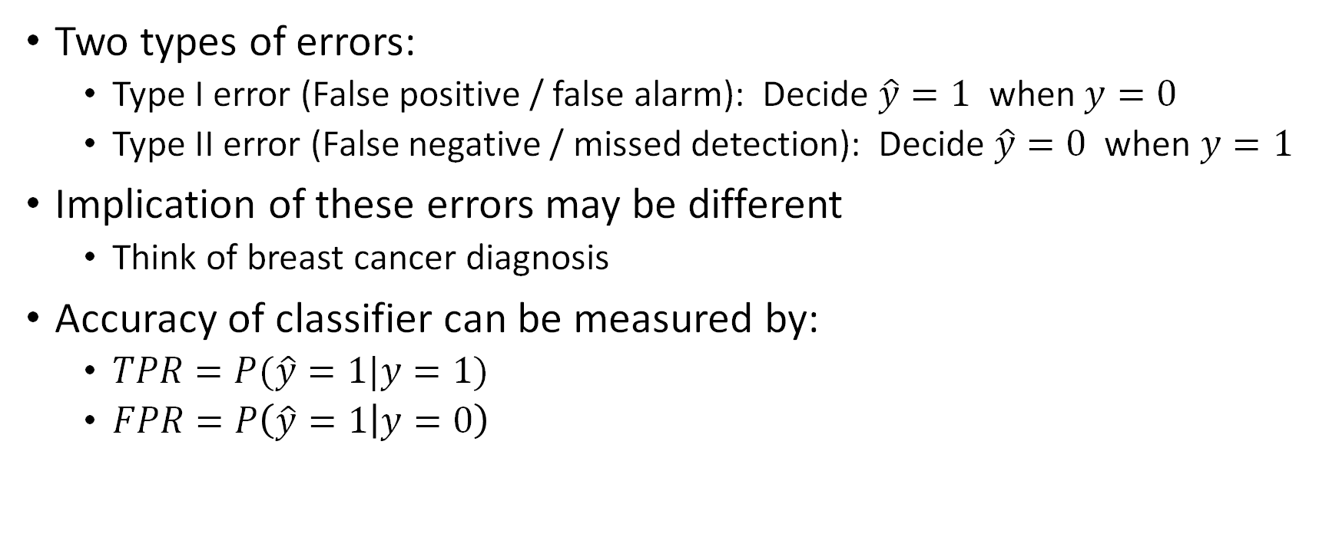
Errors in Binary Classification
Two types of errors:
Type I error (False positive / false alarm): Decide $\hat{y}=1$ when $y=0$
Type II error (False negative / missed detection): Decide $\hat{y}=0$ when $y=1$
Implication of these errors may be different
Think of breast cancer diagnosis
Accuracy of classifier can be measured by:
$TPR=P(\hat{y}=1|y=1)$
$FPR=P\left(\hat{y}=1 | y=0\right)$
[Remaining Slides from Prof. Rangan’s Intro to ML Class]

Slide 21
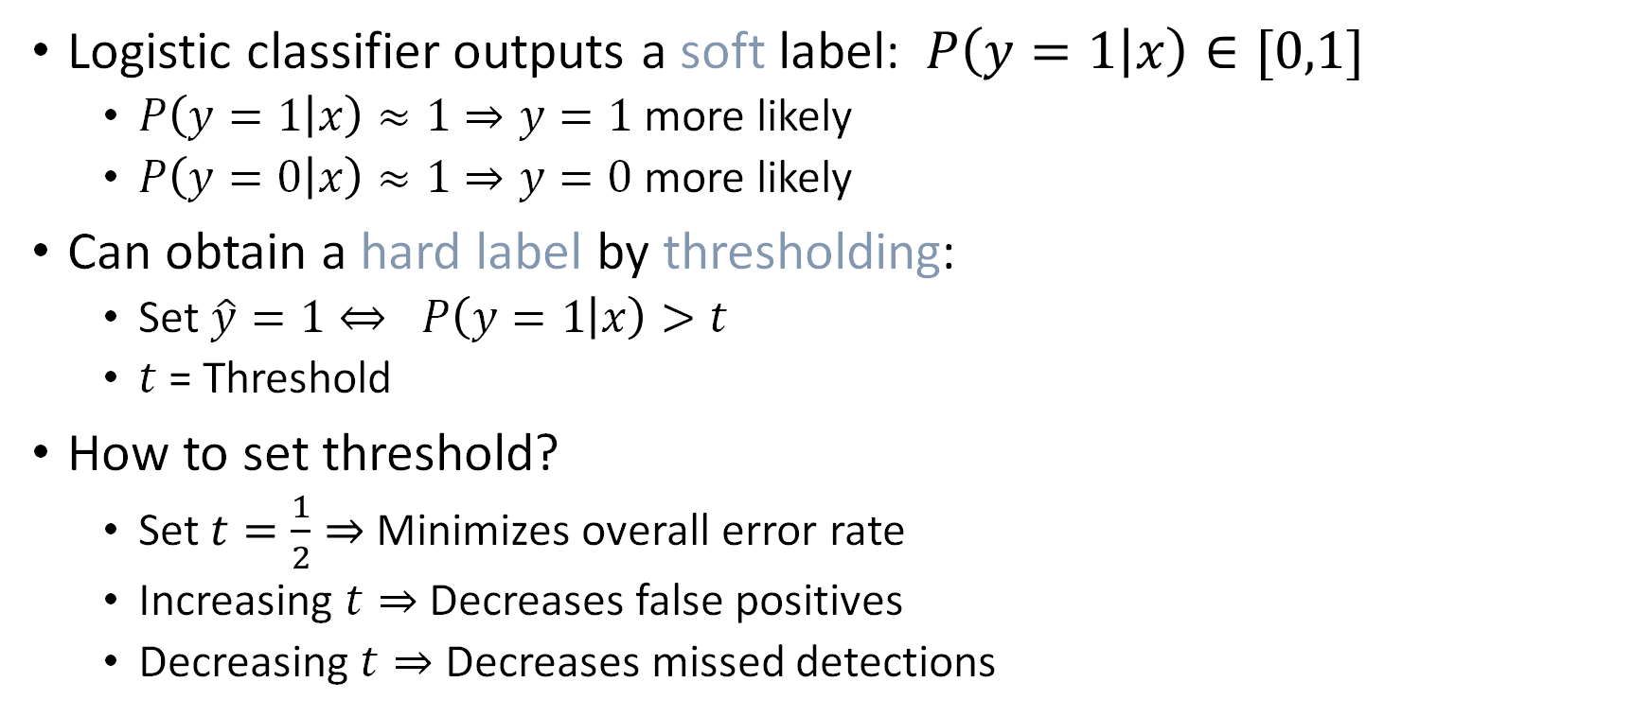
Hard Decisions
Logistic classifier outputs a soft label: $P\left(y=1 | x\right)∈[0,1]$
$P\left(y=1 | x\right)≈1⇒y=1$ more likely
$P\left(y=0 | x\right)≈1⇒y=0$ more likely
Can obtain a hard label by thresholding:
Set $\hat{y}=1⇔ P\left(y=1 | x\right)>t$
$t$ = Threshold
How to set threshold?
Set $t=\frac{1}{2}⇒$ Minimizes overall error rate
Increasing $t⇒$ Decreases false positives
Decreasing $t⇒$ Decreases missed detections

Slide 22
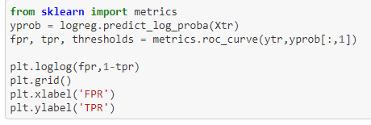
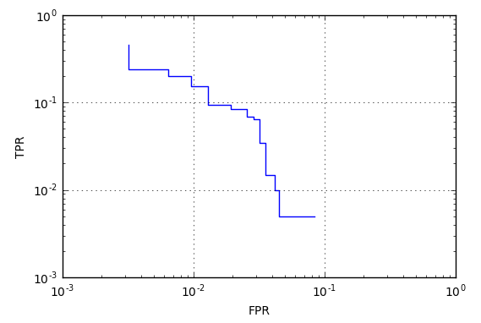
ROC Curve
Varying threshold obtains a set of classifier
Trades off FPR and TPR
Can visualize with ROC curve
Receiver operating curve
Term from digital communications

Slide 23
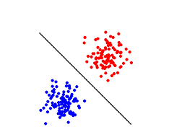
Linear Classifiers
LR based spam detector that we discussed is an example of a Linear Classifier
Decision Boundary:
Recall that:
x₂
Class 1
Class 0
Feature 2
Class 1 iff
Decision Rule
Feature 1
x₁

Slide 24

Linear Separability
Is there a transformation of the features for which this data is linearly separable?
http://www.jeannicholashould.com/public/linearly_separable.jpg

Slide 25
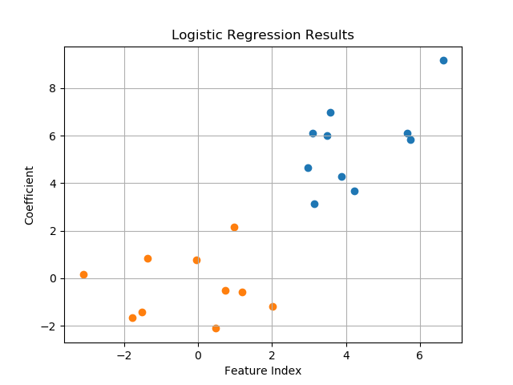
Support Vector Machines (SVMs)
All 3 classifiers have 100% training accuracy
Recall that LR attempts to minimize the log-likelihood of the training data under the LR model
LR has a probabilistic interpretation
SVMs on the other hand have a geometric interpretation
Goal: maximize margin to closest training data sample
Feature 2
Feature 1
But which of the 3 classifiers would you pick?

Slide 26
SVMs: Maximize Margin
Assume data is linearly seperable
Goal: maximize margin to closest training data sample
Let the closest points on either side lie on :
What is the value of the margin γ?
wx+b=1
wx+b=0
wx+b=-1
Feature 2
γ
γ
Maximize
Feature 1

Slide 27
SVMs: Optimization
Optimization problem
Or equivalently
wx+b=1
wx+b=0
wx+b=-1
Feature 2
γ
γ
Feature 1

Slide 28
SVMs: Non-linearly Separable
Make the constraints “soft” by introducing an “margin” ε_{i}
Note that in any solution to this problem
wx+b=1
Min
wx+b=0
wx+b=-1
Points can be misclassified with “cost” ε_{i}
Feature 2
γ
γ
Feature 1

Slide 29
SVMs: Putting it All Together
SVMs minimize the following objective
Regularization constant α
Increasing α results in greater margins at the expense of misclassifications on training data
“Hinge Loss”
Seeks to minimize mis-classfications
Tries to maximize margin (L₂ regularizer!)

Slide 30
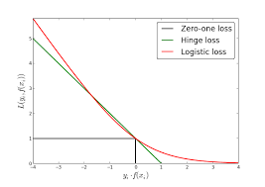
Relation to Logistic Regression
LR and SVM differ only on the loss function they use
“Log-loss” versus “hinge-loss”
LR has greater penalty for mis-classification
Hinge Loss:
Log Loss:
But also penalizes correct classification!

Slide 31

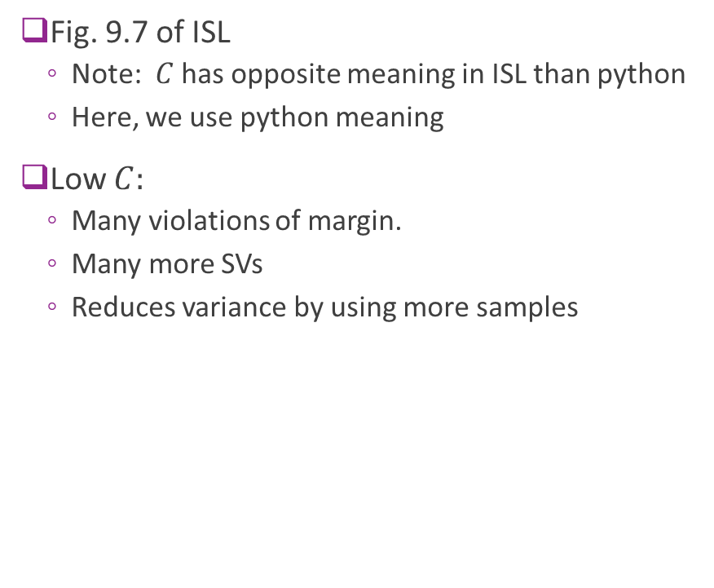




Illustrating Effect of $C$
Low $C=C_{1}$
$$C_{2}$$
Fig. 9.7 of ISL
Note: $C$ has opposite meaning in ISL than python
Here, we use python meaning
Low $C:$
Many violations of margin.
Many more SVs
Reduces variance by using more samples
$$C_{3}$$
High $C_{4}$

Slide 32
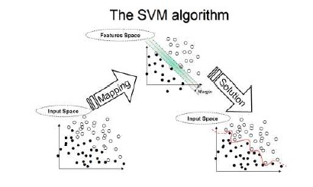
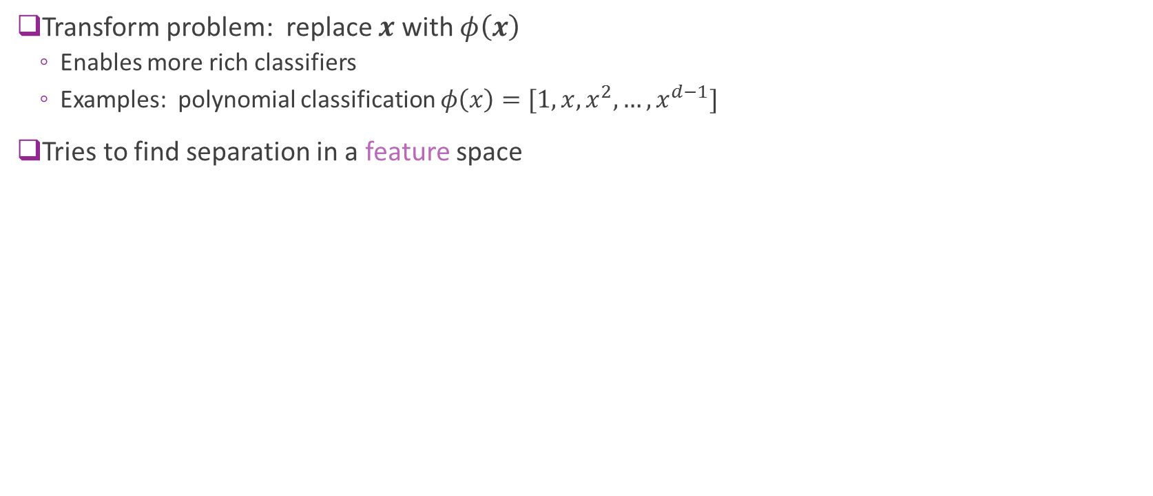
Transform Problem
Transform problem: replace $x$ with $φ\left(x\right)$
Enables more rich classifiers
Examples: polynomial classification $φ\left(x\right)=[1,x,x^{2},…,x^{d−1}]$
Tries to find separation in a feature space
From https://www.dtreg.com/solution/view/20

Slide 33
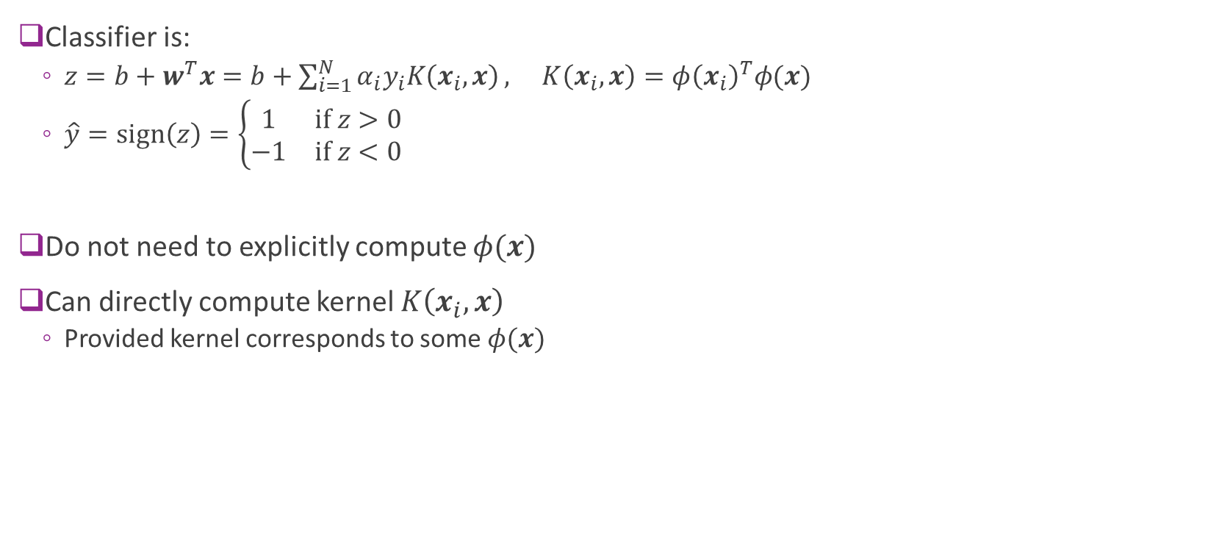
Kernel Trick
Classifier is:
$z=b+w^{T}x=b+\sum_{i=1}^{N}{α_{i}y_{i}K\left(x_{i},x\right)}, K\left(x_{i},x\right)=φ{\left(x_{i}\right)}^{T}φ(x)$
$\hat{y}=\text{sign}\left(z\right)=\left\{\begin{matrix}1 & \text{if} z>0 \\ −1 & \text{if} z<0\end{matrix}\right.$
Do not need to explicitly compute $φ(x)$
Can directly compute kernel $K\left(x_{i},x\right)$
Provided kernel corresponds to some $φ(x)$

Slide 34
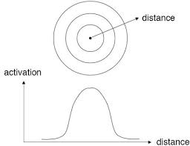
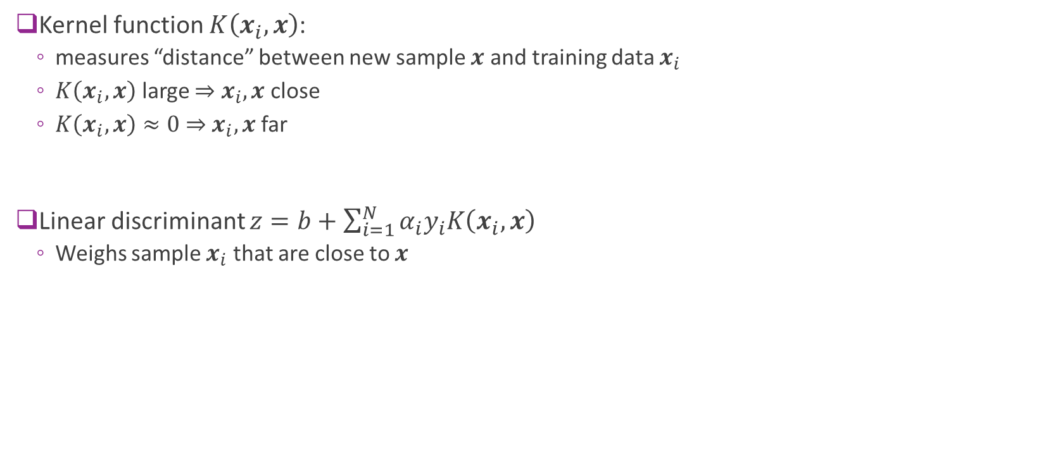
Understanding the Kernel
Kernel function $K\left(x_{i},x\right)$:
measures “distance” between new sample $x$ and training data $x_{i}$
$K\left(x_{i},x\right)$ large $⇒x_{i},x$ close
$K\left(x_{i},x\right)≈0⇒x_{i},x$ far
Linear discriminant $z=b+\sum_{i=1}^{N}{α_{i}y_{i}K\left(x_{i},x\right)}$
Weighs sample $x_{i}$ that are close to $x$

Slide 35
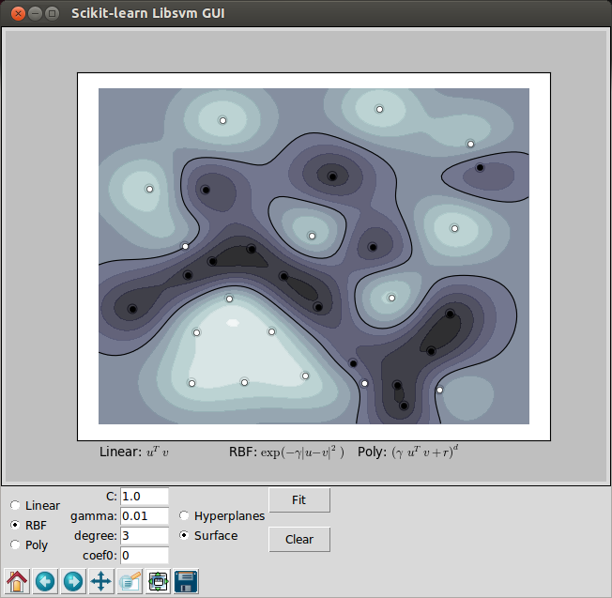
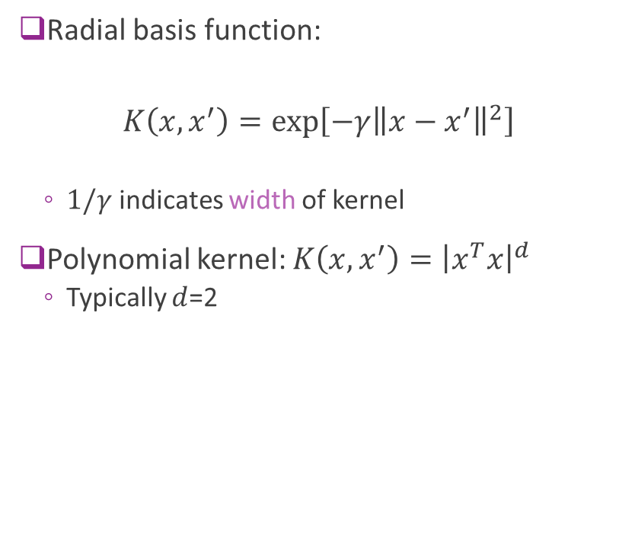
Possible Kernels
Radial basis function:
$$K\left(x,x^{′}\right)=\exp\left[−γ{\left\|x−x^{′}\right\|}^{2}\right]$$
$1/γ$ indicates width of kernel
Polynomial kernel: $K\left(x,x^{′}\right)={\left|x^{T}x\right|}^{d}$
Typically $d$=2
http://www.bogotobogo.com/python/scikit-learn/images/linearly_separable/svm_gui3.png

Slide 36
Spam Detection: Features
Recall features used in the UCI Spam database
Even easier way to encode features:
x_{i} = 1 if term i appears in a document; 0 otherwise
Boolean features
Assume M Boolean features, x = (x₁, x₂,…, x_{M})
We want to map this M-dimensional Boolean input to a Boolean output y
Thoughts?
Instead of using LR or SVM we will start with an even simpler approach referred to as “Naiive Bayes”
Ref: Metsis, Vangelis, Ion Androutsopoulos, and Georgios Paliouras. "Spam filtering with naive bayes-which naive bayes?." In CEAS, vol. 17, pp. 28-69. 2006.

Slide 37
Naiive Bayes for Spam Filtering
Assume M=1 Boolean feature, x = (x_{1,}x₂,…, x_{M})
Each email is either {s=spam,l=legit}
We begin by computing:
Bayes Rule
Ref: Metsis, Vangelis, Ion Androutsopoulos, and Georgios Paliouras. "Spam filtering with naive bayes-which naive bayes?." In CEAS, vol. 17, pp. 28-69. 2006.

Slide 38
Naiive Bayes for Spam Filtering
We begin by computing:
Assuming that term occurrences are independent (given class)!
Is this a reasonable assumption?

Slide 39
Naiive Bayes for Spam Filtering
How do we estimate this from the training dataset?
(#Spam emails that contain term 1)/(#spam emails)
What happens if term 1 never occurred in any spam email in the training dataset?

Slide 40
Laplacian Smoothing
(#Spam emails that contain term 1)/(#spam emails)
= (#Spam emails that contain term 1+1)/(#spam emails+2)
Equivalent to assuming two addition spam emails in the training dataset, of which on contains all terms and the other is empty
= (#Spam emails that don’t contain term 1+1)/(#spam emails+2)

Slide 41
Naiive Bayes for Spam Filtering
Vs.
Or:

Slide 42
References
Cormack, Gordon V. "Email Spam Filtering: A Systematic Review." Foundations and Trends® in Information Retrieval 1.4 (2008): 335-455. https://www.ccs.neu.edu/home/vip/teach/IRcourse/IR_surveys/spam-filtering.pdf
Metsis, Vangelis, Ion Androutsopoulos, and Georgios Paliouras. "Spam filtering with naive bayes-which naive bayes?." In CEAS, vol. 17, pp. 28-69. 2006.

